Slide 1
Echo in Heart Failure Relevant to surgeons
K. Chandrasekaran, MD, FACC, FASE

Slide 2
What Surgeon NEEDS
Lesion and its operability
Coronary Artery Disease
Valvular Heart Diasese
Stenosis
Regurgitation
Pericardial Disease
Congenital Heart Disease

Slide 3
50/M, HTN, s/p AMI presents with HF

Slide 4
Surgical Ventricular Restoration – CHF Post-Infarction Ventricular Dilation
Survival – EF
Survival – Shape
J Am Coll Cardiol 2004;44:1439–45

Slide 5
Post Bypass

Slide 7
What does surgeon need?
LV Geometry –
Spherical or Oval
LV ESV volume
Wall Motion – Dyskinesis or Akinesis
Mitral Regurgitation
Functional – mitral apparatus
Lealfet pathology
RV function

Slide 8
66 / F, HTN, DM, presents with HF DOE, PND, Fatigue

Slide 9
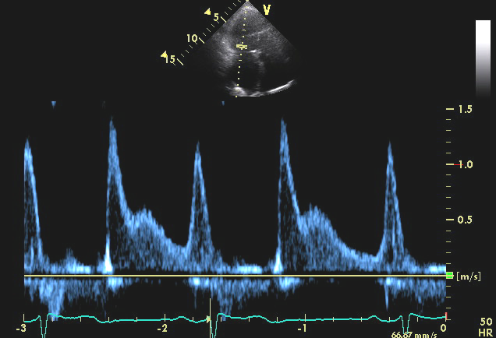
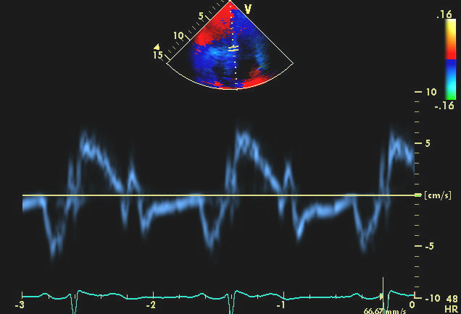
E/e’ 35
LV EF 65%,
LAVI 45 ml/m2

Slide 11
Aortic Stenosis – LVH
Kupari etal,.E H J (2005) 26, 1790–1796

Slide 12
Aortic Stenosis – Calcification
> 4.0 m/s 2.5 to 4.0 m/s
Freeman & Otto Circ. 2005;111:3316-3326

Slide 13
What does surgeon need?
Aortic Valve & Aortic root :
Morphology – Tricuspid, Bicuspid
Calcification – Localized vs extensive
Aortic hemodynamics :
Mean gradient, Cardiac Index
LVOT – Geometry & calcification
Ascending Aortic geometry
LV Mass index

Slide 14
60/M, HTN, presents with acute HF

Slide 16
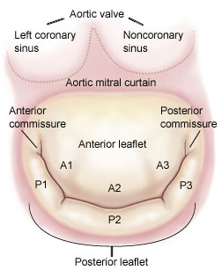
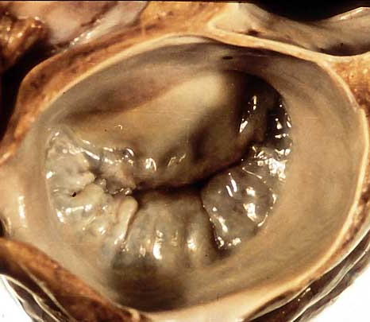
Mitral Valve Anatomy: View from the Left Atrium
Carpentier Nomenclature
A3
A2
A1
P3
P1
P2

Slide 17
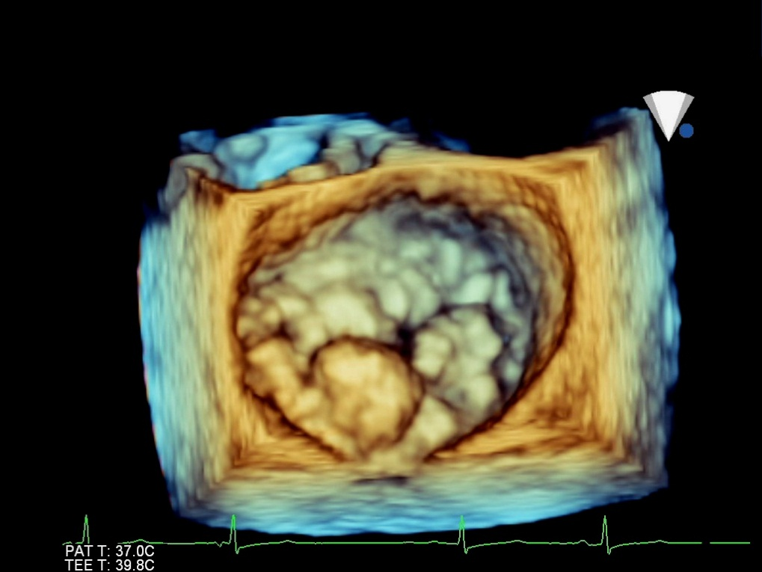

Slide 20
What does surgeon need?
Mitral Valve:
Abundance and mobility of leaflet tissue
Localized vs Extensive
Anterior leaflet length / angle
Location and extent annular calcification, TR severity (TTE)
Bileaflet disease
- Prioritize scallops, Clefts - Anatomy-leak, Commissural jets - Saline test in a flaccid heart

Slide 21
What does surgeon need?
Post Repair:
SAM – LVOT obstruction
Prompt answer on residual severity and location and mechanism under optimal hemodynamic conditions

Slide 22
Thank you

